Slide 1

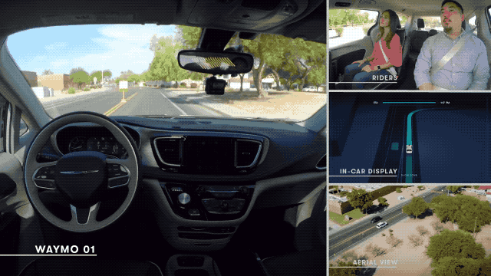

Module 1.3
Anatomy of Self-Driving Vehicles & Applications
Living and Working with Artificial Intelligence
Source: TechCrunch - Darrell Etherington
Developed for the AI4GA (Artificial Intelligence for Georgia) project funded by National Science Foundation awards DRL-2049029 and DRL-2048502.
This work is licensed under the Creative Commons Attribution-NonCommercial-ShareAlike 4.0 International License. https://creativecommons.org/licenses/by-nc-sa/4.0/

Slide 2
Watch the video and try to answer the questions:
How do you think the self-driving car works?
What did you find interesting from the video?
Warm-up

Slide 3
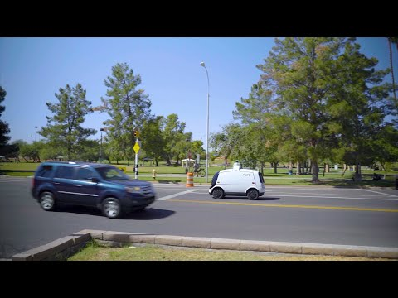
Video:
Nuro Pizza Delivery
https://www.youtube.com/watch?v=yFTYljZc968I (2:24)
Notes:
Watch together in whole group.

Slide 4
Any ideas?
How do you think the self-driving car works?
What did you find interesting from the video?
Warm-up Answer

Slide 5
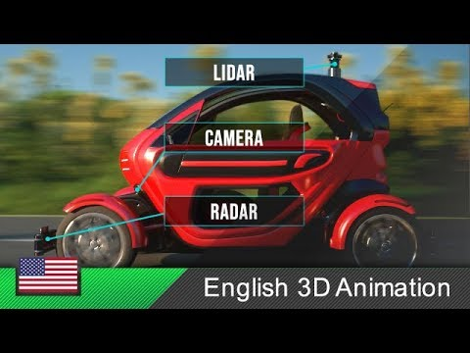
Activity 1
Watch the Video:
Anatomy of a Self-Driving Car
Complete the Worksheet section Activity 1.
https://www.youtube.com/watch?v=gEy91PGGLER0 (3:11)
Notes:
Watch in partners or small groups while completing the chart.

Slide 6
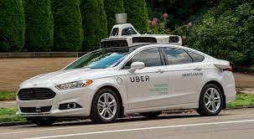
LiDAR: Light Detection and Ranging
Distance
LiDAR can see about 1.5 football fields.
The LiDAR sensor is often mounted on the roof and rotates to get a 360º view.
Lower resolution LiDAR sensors are sometimes placed around the bumpers for obstacle detection.

Slide 7
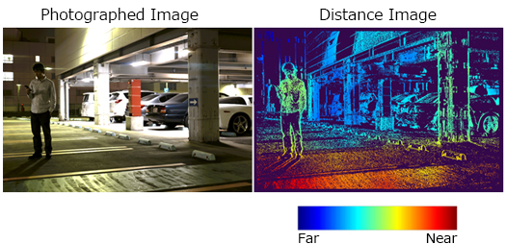
LiDAR technology uses infrared laser light to create a three-dimensional image of an environment.
LiDAR works by sending out pulses of infrared light
It measures the time it takes for the light to bounce off objects and return to the sensor

Slide 8
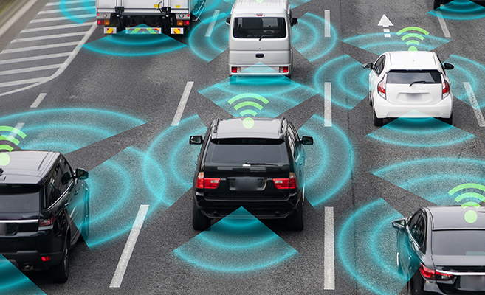
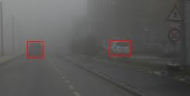
RADAR - Radio Detection And Ranging
Radar uses radio waves instead of light
Advantage - can see through fog, rain, snow, or other low visibility conditions.
Radar is used for obstacle avoidance like LiDAR.
Radar is lower resolution than LIiDAR, but also less expensive.
RADAR in Foggy Conditions
car
car
Notes:
3rd Period Starts Here and needs to do Activity 2 and 3

Slide 9
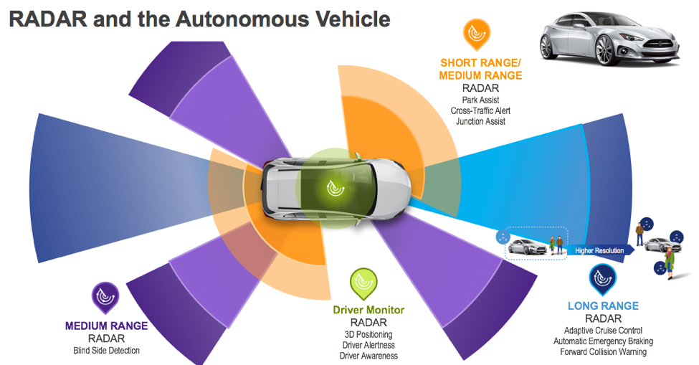
Radar for Obstacle Detection in Low-Visibility Situations
Figure from https://semiengineering.com/here-comes-high-res-car-radar/

Slide 10
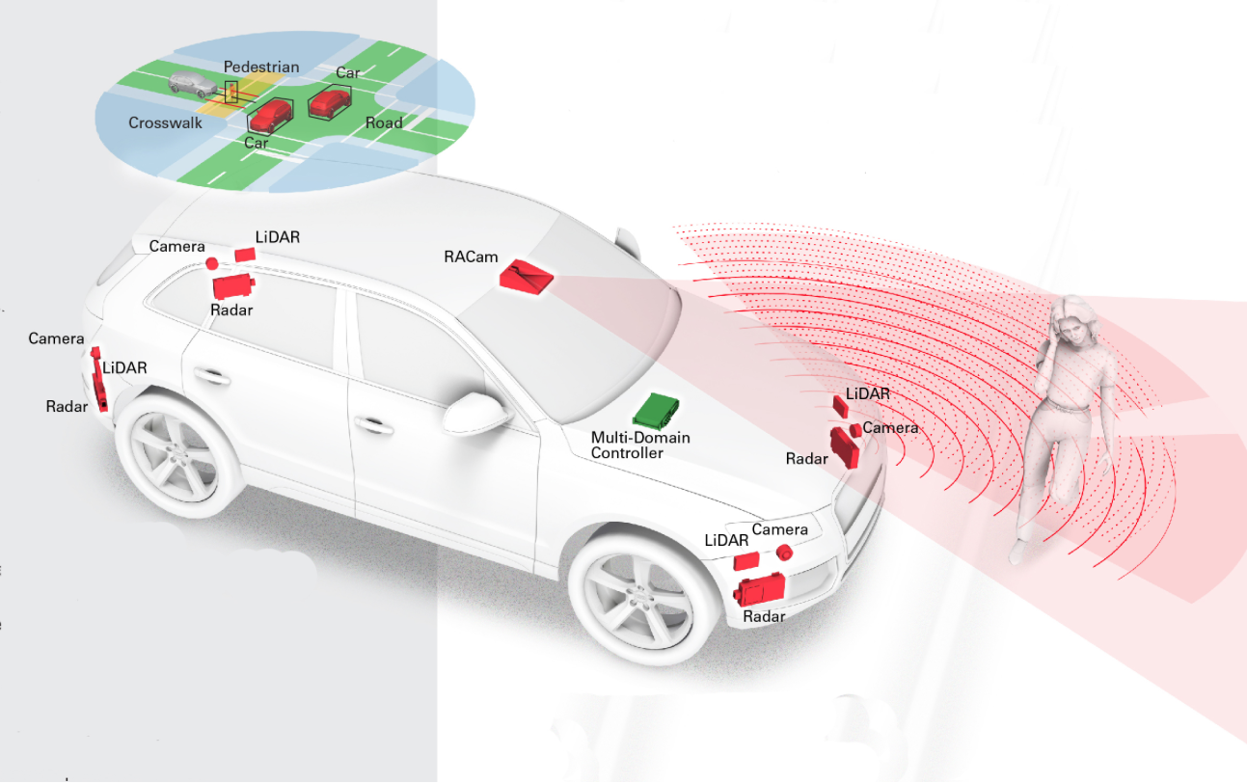
Sensor fusion: RADAR + LiDAR
Notes:
https://medium.com/@andymohd/the-incredibly-shrinking-world-of-vehicle-radar-design-b82f4077922b

Slide 11
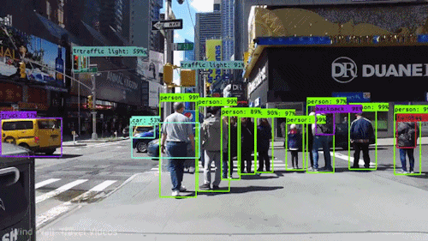
Computer Vision - How self-driving cars see
What sensor do you think it
uses to:
Read traffic signs
Read traffic lights
Detect lane markers
Which sensors do you think it
Is using to:
Pedestrian detection
Obstacle detection

Slide 12
Computer Vision - How self-driving cars see
Camera (visible light only)
Read traffic signs
Read traffic lights
Detect lane markers
Sensor Fusion:
Camera, LIDAR, RADAR
Pedestrian detection
Obstacle detection

Slide 13
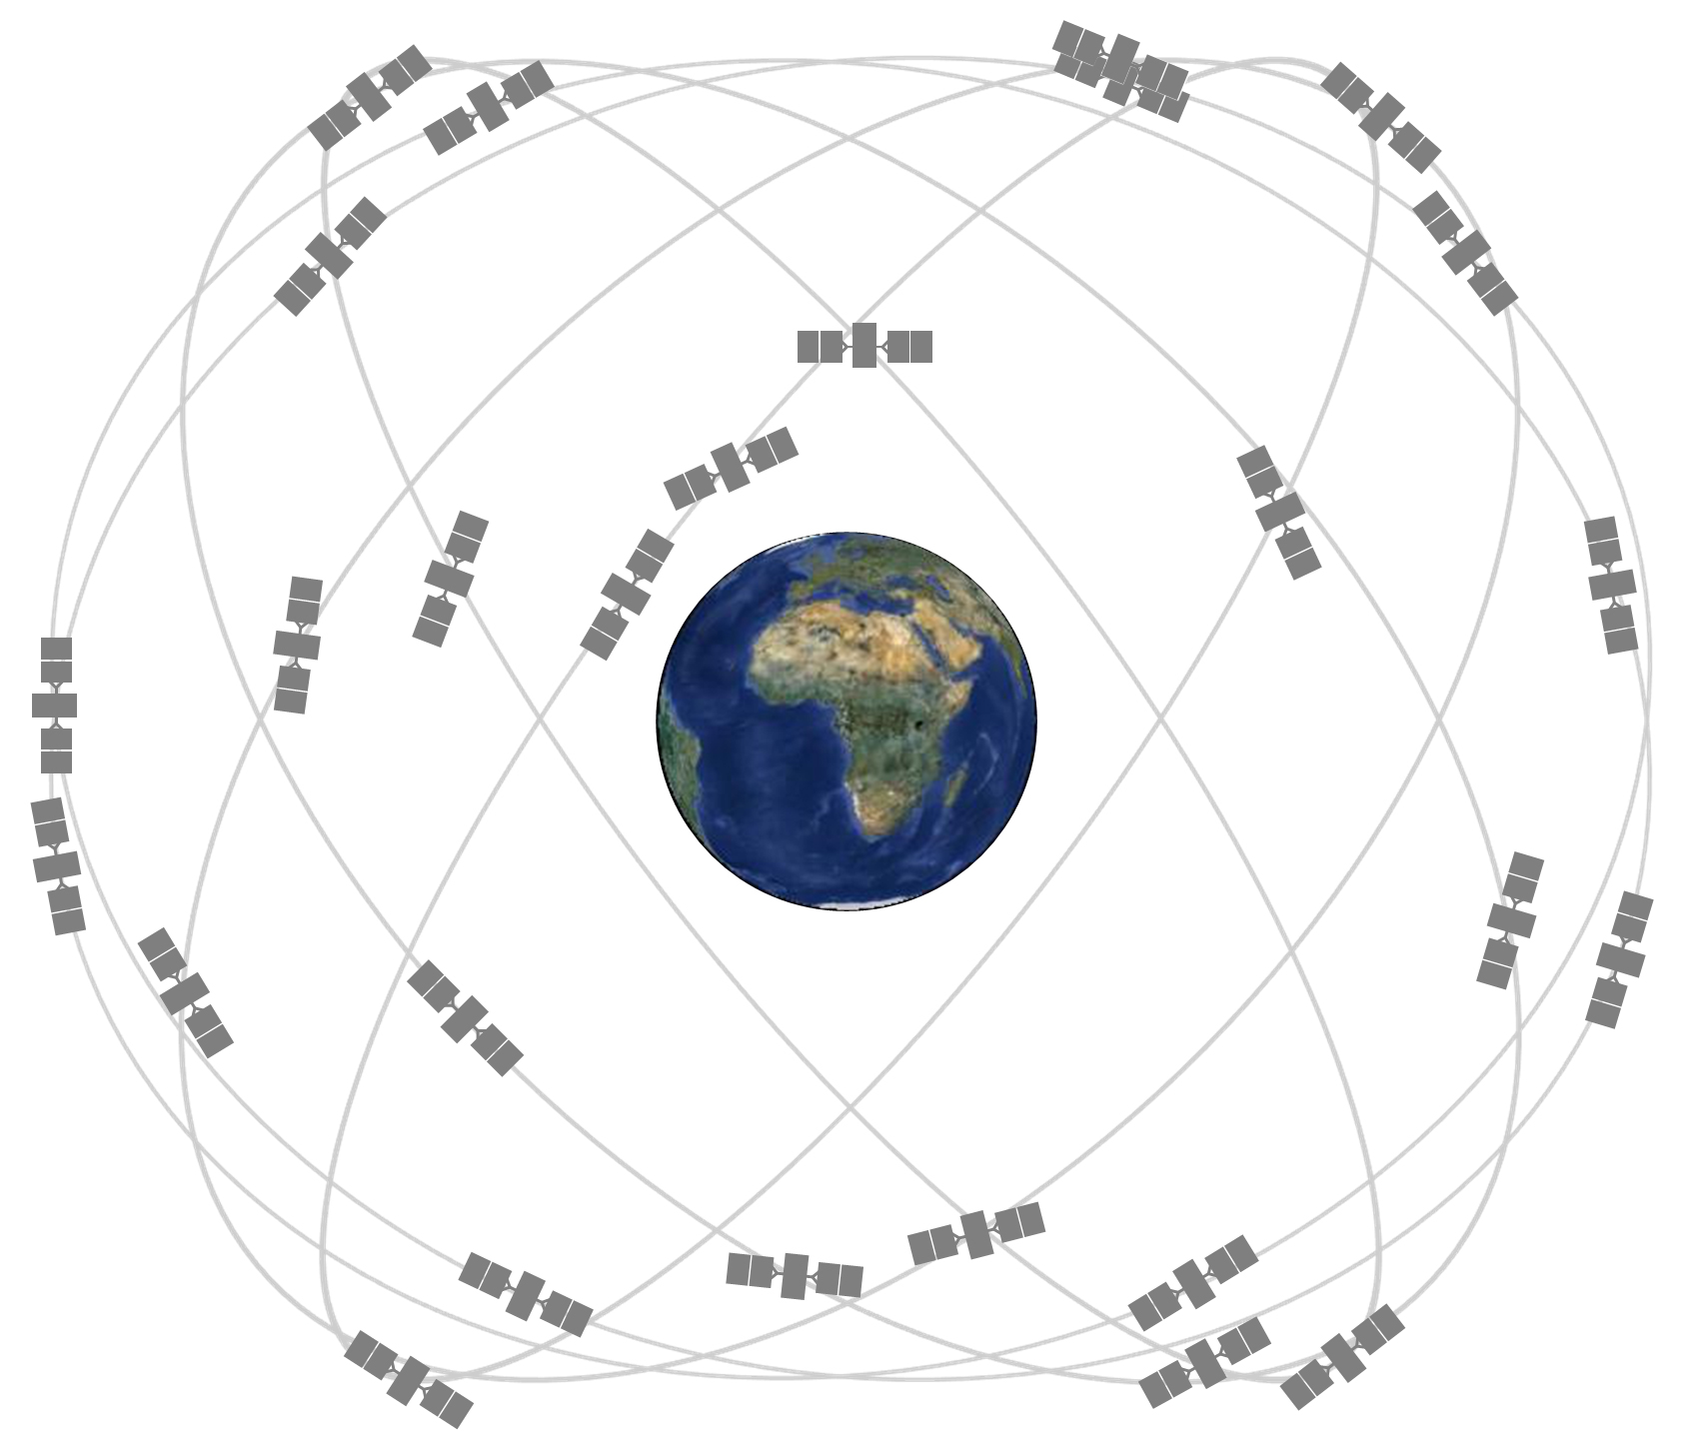
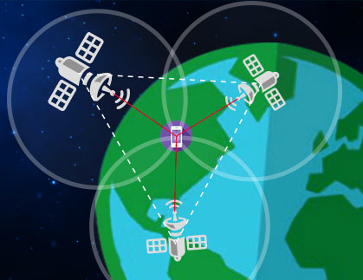
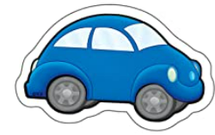
GPS: The Global Positioning System
How does GPS Work?
GPS is a network of satellites orbiting earth
Each satellite has an atomic clock
Each satellite broadcasts the time and its trajectory
By combining data from multiple satellites
and looking at the time differences, a GPS
receiver can calculate its position.
This is called triangulation.
GPS is a network of satellites orbiting Earth
Notes:
*
()
* *

Slide 14
How Triangulation Works
If we know where the satellites are, plus our distance from each satellite, we can calculate our own location as the place where all the circles intersect.
GPS receiver
satellite
circle: radius = distance to satellite
distances

Slide 15

Video:
Nuro Pizza Delivery
Once we finish the video the next slide will help you with Activity 2.
https://www.youtube.com/watch?v=yFYljZc968I (2:24)

Slide 16
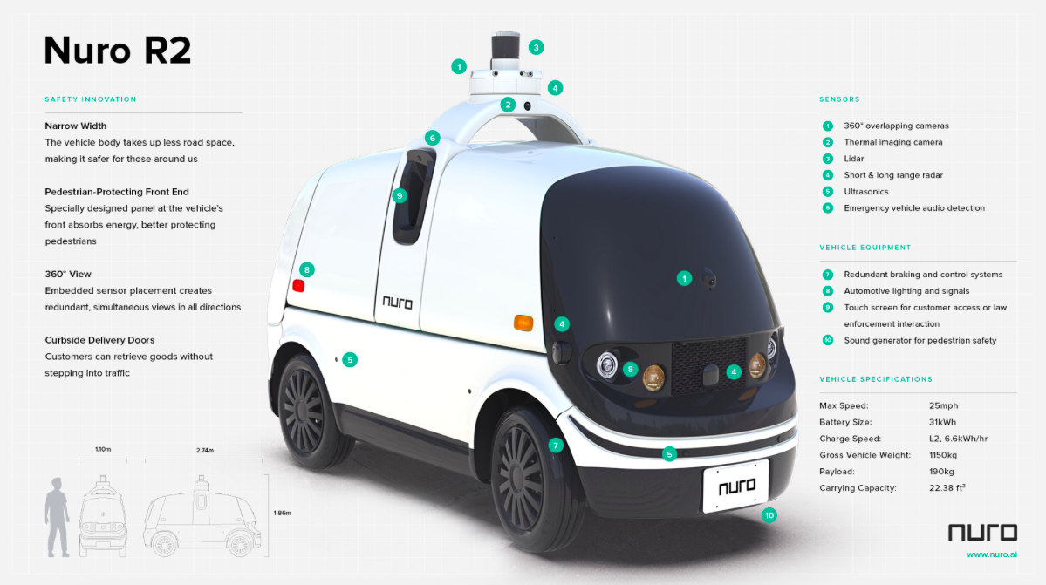

Slide 17
Module 1.3: Part 2
Self-Driving Cars:
System-Level Description
Notes:
Mini-lecture:
Autonomous Car System-level view - break down the anatomy of a self-driving car video
What is a system? What is a subsystem? What is a sensor?
Have them try this out by exploring a cell phone or everyday technology
Roles & goals of Sensors, subsystems
Tool: Interactive Graphics - KISS Rule

Slide 18

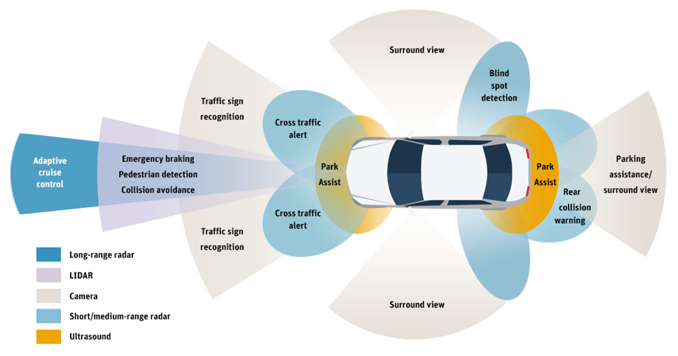
1. Perception: How different sensors help the car operate
Notes:
https://create.arduino.cc/projecthub/massimo0572/car-radar-safety-6766d2
Behaviors a car can exhibit
Surround view - switching lanes, on-coming traffic, monitoring
Blind spot detection - comprehensive picture of the environment

Slide 19
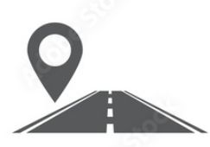
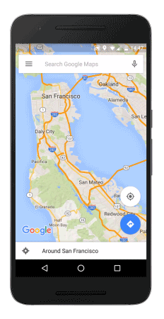
2. Localization - How GPS is used in navigation
Self-driving cars’ use of GPS:
GPS tells the car where it is in the world (latitude, longitude)
The navigation system uses GPS data to determine where the car is on a map, and track its progress along its planned route.
Notes:
Consider reducing text by making this a table.

Slide 20
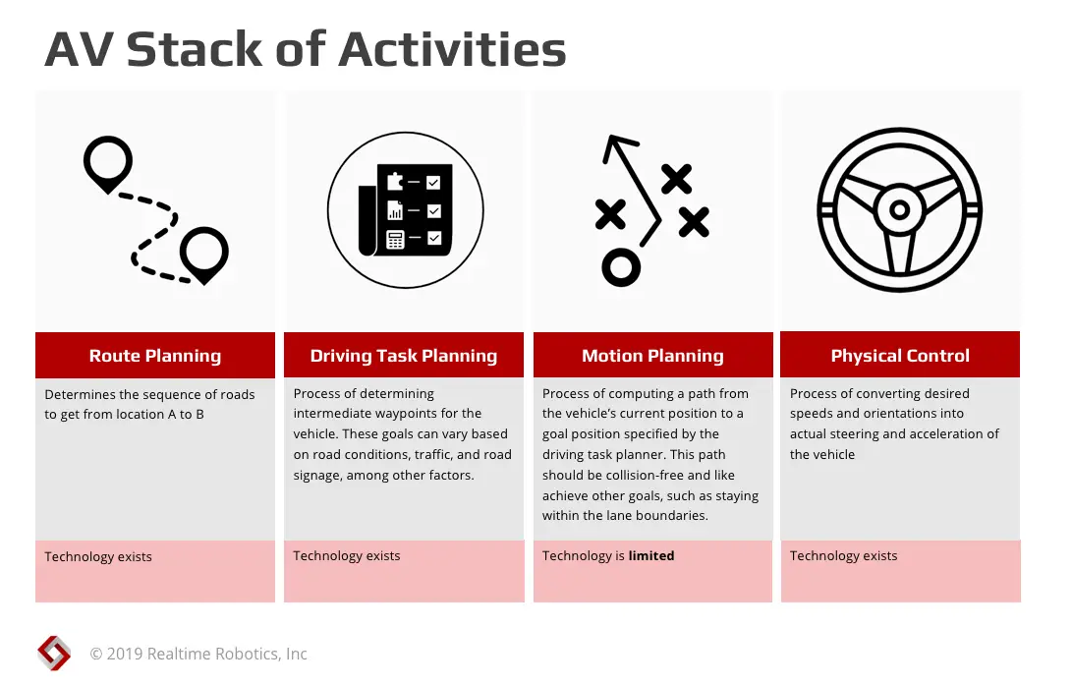
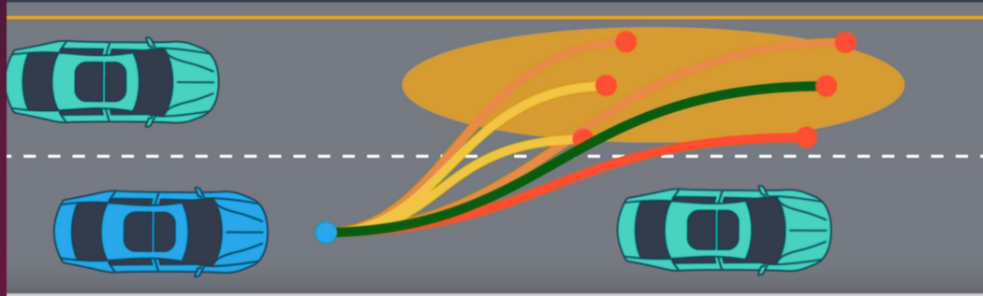
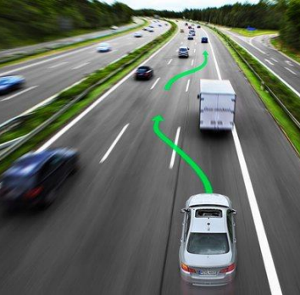
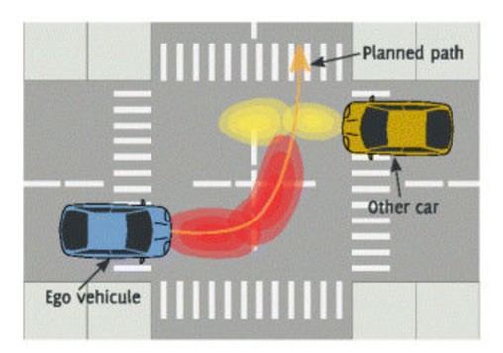
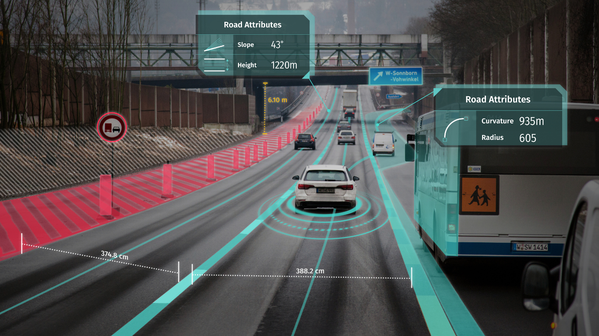
3. Maneuver Planning
What are vehicle maneuvers?
A maneuver is a movement or series of moves requiring skill and care.
The basic maneuvers a car must do include entering and leaving traffic, right and left turns, lane changes and turning the car around, parking, and U-turns.
Lane Change
Passing Another Vehicle
Left Turn Across Traffic
Taking An Exit Ramp
Notes:
https://thinkautonomous.medium.com/can-self-driving-car-think-6c9e8d939d60
3-point turn - WAYMO article
Left turn figure is from https://jonathan-hui.medium.com/self-driving-car-path-planning-to-maneuver-the-traffic-ac63f5a620e2 which cites the source as https://robomechjournal.springeropen.com/track/pdf/10.1186/s40648-014-0001-z.pdf

Slide 21
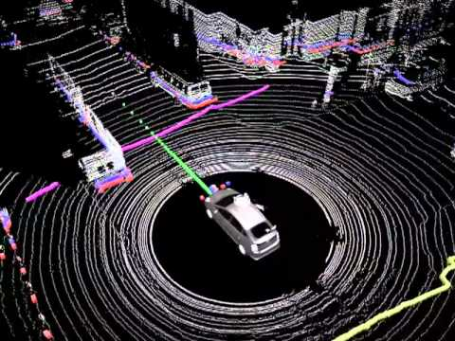
Visualization of LIDAR Data to Maneuver
https://youtu.be/nXlqv_k4P8Q (1:12)

Slide 22
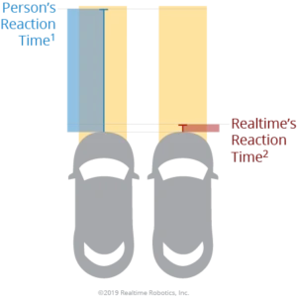
4. Vehicle Control
Operating the:
Steering wheel
Accelerator (gas pedal)
Brakes
Turn signals
to smoothly execute the maneuvers the car needs to perform.
Computers can respond more quickly than humans for emergency braking.

Slide 23
My Dream Bot
Over the course of Unit 1, you will design your own dream robot.

Slide 24
Lesson 1.3 (A): Exit Ticket
Tip: Students should complete in their own Dream Bot slides
What things will your dream robot be able to sense? What kinds of sensors is it going to use?
My robot uses… to sense…
My robot uses… to sense…
My robot uses… to sense…
My robot uses… to sense…
My robot uses… to sense…

Slide 25
Autonomous robots require the same skills as self-driving cars

Slide 26
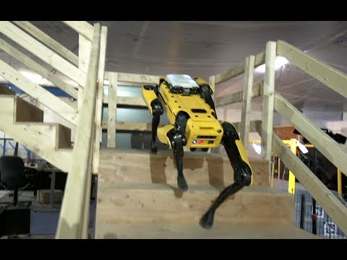
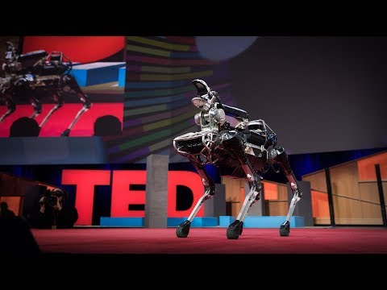
Robot building a map using sensors and avoiding obstacles

Slide 27
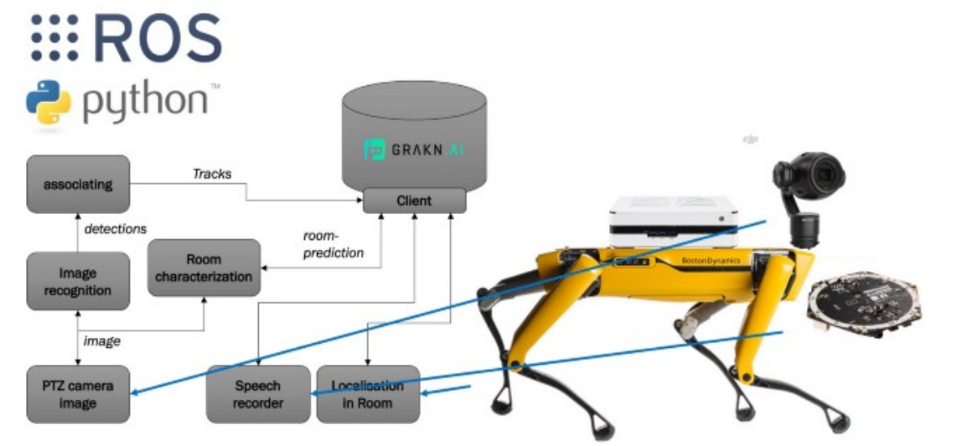
AI Systems in Spot - Boston Dynamics Robot
Notes:
Source: https://dzone.com/articles/object-recognition-and-spacial-awareness-for-a-spo
Where Am I?
Where Am I going?
How do I keep Safe?
Autonomy - takes many different forms
Add Roomba

Slide 28
(Move to additional resources) Deeper Dive Overview
Mini- lecture: Introduce Research projects and how to do research projects
Student Articles
https://www.datadriveninvestor.com/2019/11/14/the-anatomy-of-self-driving-cars/
https://www.popsci.com/how-self-driving-cars-change-lanes/
NASA Article - GPS
Videos: https://www.cnn.com/videos/business/2021/04/12/dominos-pizza-delivery-robot-nuro-gr-orig.cnn/video/playlists/business-robots/

Slide 29
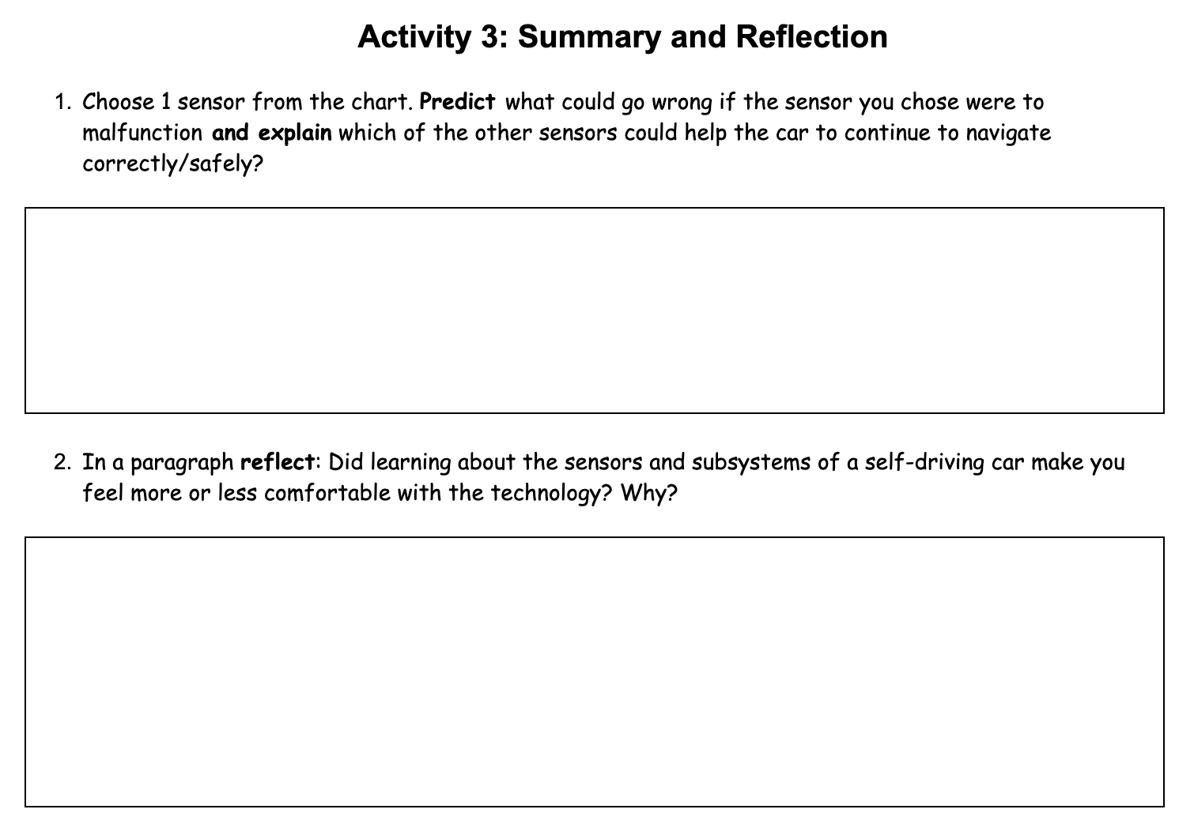
Work on Activity 3

Slide 30
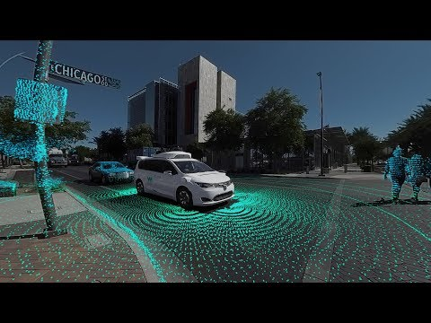
ActVideo: Inside a Self-Driving Car
https://www.youtube.com/watch?v=B8R148hFxPw (3:36)
Notes:
Videos/Classroom- Level viewing of all 3 videos (15 mins)
Video - Inside a self driving car
Video - anatomy of a self-driving car
Video - Nuro Pizza delivery

Slide 31
My Dream Bot
Over the course of Unit 1, you will design your own dream robot.

Slide 32
Lesson 1.3 (B): Exit Ticket
Tip: Students should complete in their own Dream Bot slides
What does your robot look like physically?
My robot looks like?
  Describe your robot
  Where are all of the sensors located on the robot?

Slide 33
Create Your Robot
Tip: Students should complete in their own Dream Bot slides
Create options:
a labeled drawing
A description and diagram
3D model
Cardboard model

Slide 34
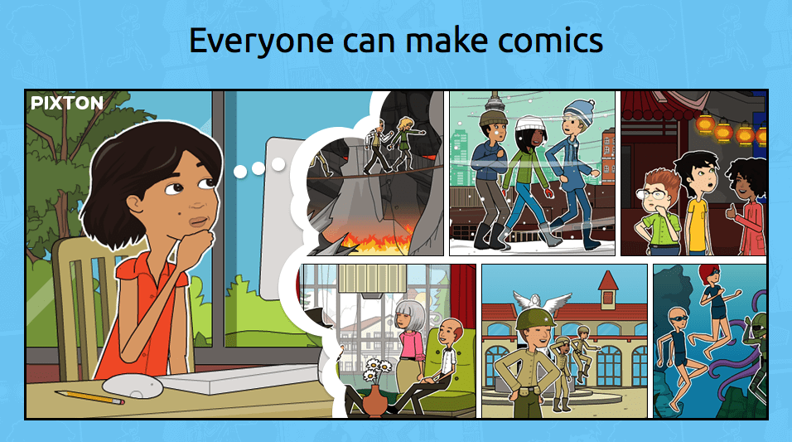
Comic Strip Assignment
You may use:
storyboardthat.com/storyboard-creator

Slide 35

INSTRUCTIONS
  Research and create a comic that describes/explain five (5) different types of sensors on self driving cars and how are they used. Remember to cite your source(s).
****After you have completed the assignment, explore and have fun using the comic creator site. Create more comics, practice storytelling, create a personal comic for a sister, brother, or family member.

